Slide 1
WELCOME TO
Smart-GAT
Tourism made Easier

Slide 2
WHAT IS IT ?
Smart – GAT is an self-guiding automated system for tourists via which the tourism industry would take a leap towards a more attractive and progressive future.
It is a compact system that will guide you throughout your way, thereby exploring each and every aspects of that place. Everything that you need to know about various places that you are visiting whether it’s history or it’s significance would be provided to you by our system .It would also be providing each and every intricate details regarding any sculpture or any ancient painting. Our system would not only be providing the relevant details of any historic fort or palace but also its ancestoral hierarchy.

Slide 3
Hill Forts of Rajasthan
The serial site, situated in the state of Rajasthan, includes six majestic forts in Chittorgarh, Kumbhalgarh, Sawai Madhopur,Jhalawar, Jaipur, and Jaisalmer. The eccentric architecture of the forts, some up to 20 kilometres in circumference, bears testimony to the power of the Rajput princely states that flourished in the region from the 8th to the 18th centuries. Enclosed within defensive walls are major urban centres, palaces, trading centres and other buildings including temples that often predate the fortifications within which developed an elaborate courtly culture that supported learning, music and the arts. Some of the urban centres enclosed in the fortifications have survived, as have many of the site's temples and other sacred buildings. The forts use the natural defenses offered by the landscape: hills, deserts, rivers, and dense forests. They also feature extensive water harvesting structures, largely still in use today.

Slide 4
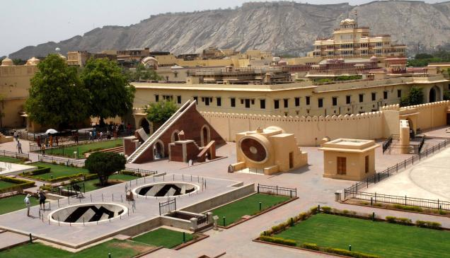
A recent study showed that from every single tourist around 13 people profits directly or indirectly. Local transporters, hotels, shopkeepers, monuments, museums, guide and tour operators are just a few who survive through tourists. If proper efforts are taken, then 30% of the total population of Rajasthan can live from tourism. Rural tourism of Rajasthan could bring enormous wealth to the villages of Rajasthan.

Slide 5
HOW IT WORKS !
FRONTEND USAGE:
Each monument would be fitted with a card, which basically is an IDENTIFICATION DEVICE with UID. The tourists would be provided with a device built with Arduino, an LCD screen 3.5MM jack and most importantly an RFID sensor. The sensor in the device would have to be brought near the card and scanned. Once it scans the card, the whole information would be displayed as text on the screen and by connecting the headphones, you can also hear the audio. Internal speakers will also be attached with the device in order to amplify the audio and background cancellation.
BACKEND USAGE:
All the text and audio file would be included in the arduino coding, which would remove the hassle of Wi-Fi transmission from the card to device. Just by scanning the code, the device would access the data of that particular area and would display on the screen and the audio would be heard.

Slide 6
EQUIPMENTS USED
Arduino Uno R3
LCD
RFID 125khz
Male to female, female to female, male to male connectors
Bread board
Potentiometer
resistor

Slide 7
Future Scopes
Offline Maps And Online App:-
We would be developing an offline as well as online app for our system so that whole of the information could be easily accessed on the smartphones.
Our app would simply include a Q-R code reader that could be used to scan the information and it would be displayed on the users smartphones.
Another striking feature of our app is the availability of offline maps that could guide the tourists through his way to his destination (forts or palaces).

Slide 8
Uses
Our system found its use in various places:-
It can be easily implemented in colleges ,universities ,hospitals, shopping malls and also in historic museums and many more places.
Our system is not only limited to tour spots but also for security purposes such as identification of genuine entries to a government department or other reserved premises.

Slide 9
Made and Presented By:
Amrit Ganjoo [L]
vardan
Himanshu kumar

Slide 10
Thank You

